Slide 1
HBA Women In Science Affinity Group
2018 Women in Science Events

Slide 2
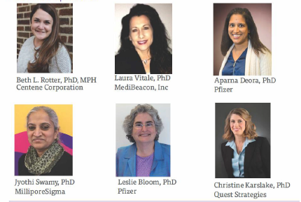

Boost your Career with Women in Science
WIS - Mid-Atlantic Region
St. Louis, Chair: Elaine Ladd
October 11, 2018
Sponsors:

Slide 3
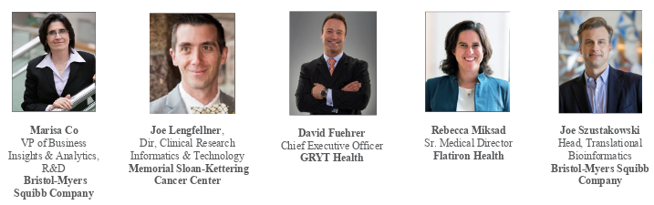
Digital Health Disruption – How it Enhances Patient Care
WIS - NY/NJ Region
WIS Co-leads: Lillian Seu, Natalie Daurio, Jean Chow
September 27, 2018 at Bristol-Myer’s Squibb, NJ
Event Sponsor: Bristol-Myer’s Squibb
Panelists:

Slide 4
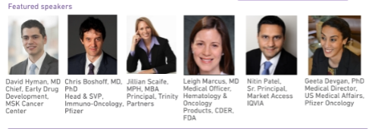
Tissue-Agnostic Cancer Drug Development:
A Paradigm Shift?
WIS - NY/NJ Region
October 23, 2018 @ Pfizer HQ, NYC
Event Sponsors: Trinity Partners and Pfizer
WIS Co-leads: Ying Liu, Deshanie Rai, Jean Chow

Slide 5
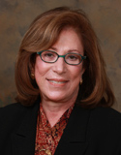
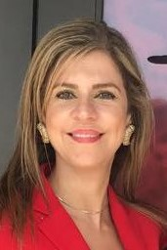
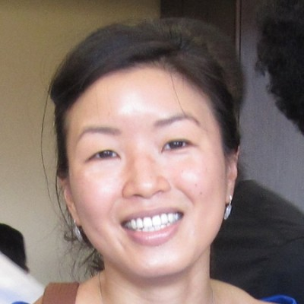
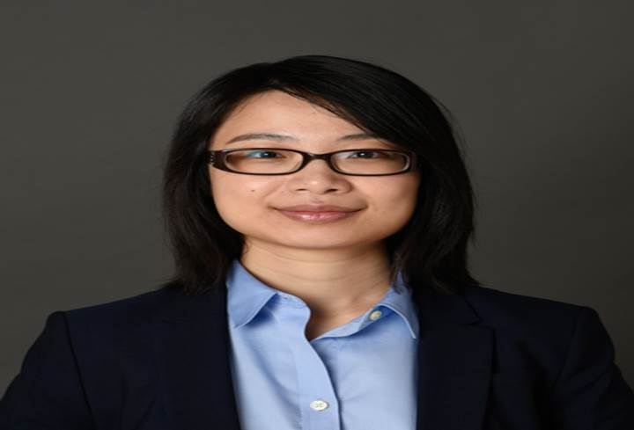
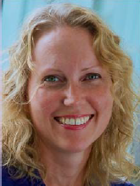
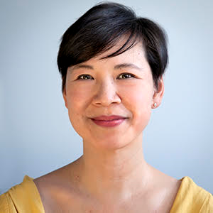
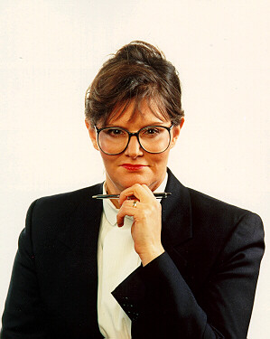
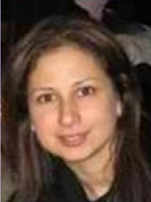
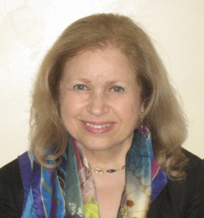
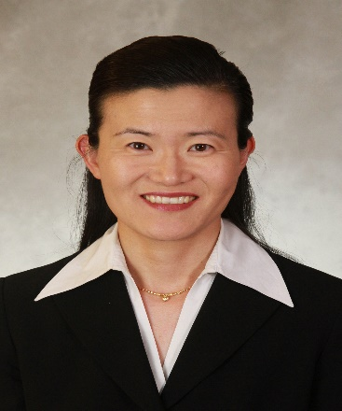
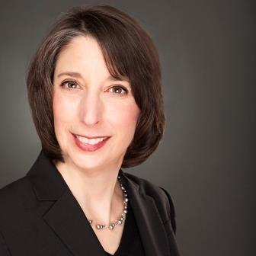
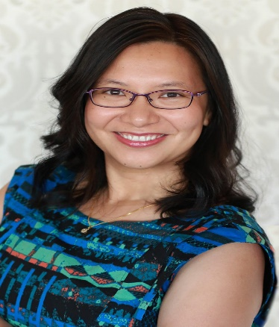
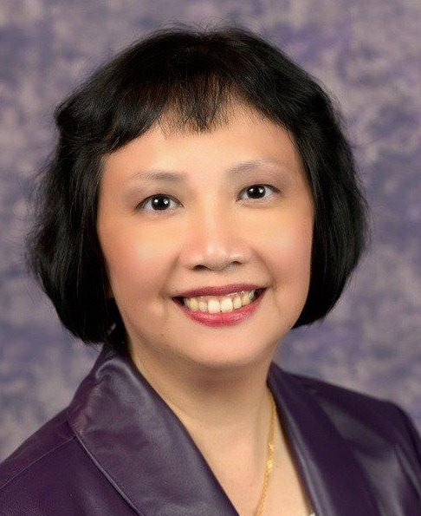
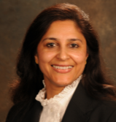
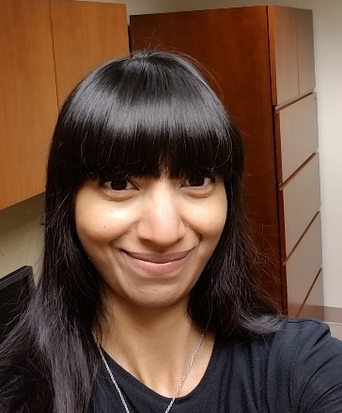
Thank you to our WIS NY/NJ team for their support on these events!
WIS NY/NJ Co-Chairs:
Jean H Chow, MS, MD
Deshanie Rai, PhD, FACN
Lillian Seu, PhD
Natalie Daurio, PhD
Juliet Hart
Tasha Simms, PhD
Lisa Weiss, PhD
Ying Lin, PhD
Kelly Park, Pharm D
Adrianne Wong, PhD
Sharon M Roberts
Rama A Shmeis, PhD
Miriam Marshood, PhD
Donna Mildvan, MD
Candice Hughes, PhD
Anindita Sinha, MS

Slide 6
Cool Things Happen at the Edges
WIS - New England Region
Thursday, September 20, 2018
5:30-8:30 PM
Amgen, Cambridge, MA
Featured Speaker
Dr. Erika Ebbel Angle, PhD
CEO & Co-founder, Ixcela
Founder, Science From Scientists
Event Host & Sponsor

Slide 7
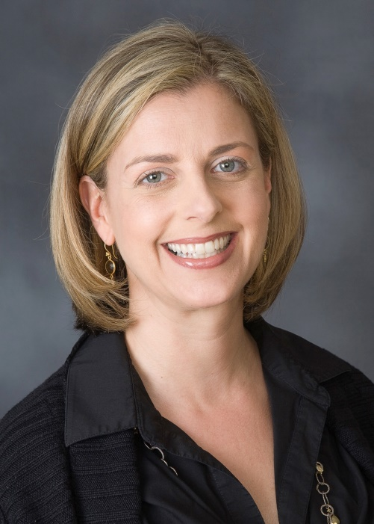
Navigating your scientific career: Finding a fulfilling direction
WIS - Pacific Region
The WIS signature event, held on November 1st at Genentech, was the inaugural event of the WIS affinity group in the Pacific Region. HBA members had an opportunity to network with those who have experienced the transition and with their peers. Coaching, mentoring, and advice from those who share a passion for science but have advanced their careers on different paths was priceless.
Keynote Speaker and Panel Moderator: Gisela Paulsen, SVP, Global Head of Clinical Operations at Roche/Genentech
Attendees: >70 HBA members
Learning objectives:
1. Grow you network of women with a scientific background.
2. Understand career choices you can make with a scientific degree.
3. Assess and develop the skills needed for a fulfilling career.

Slide 8
HBA Women In Science Affinity Group

Slide 9
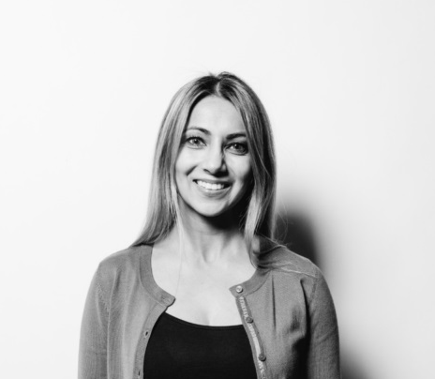
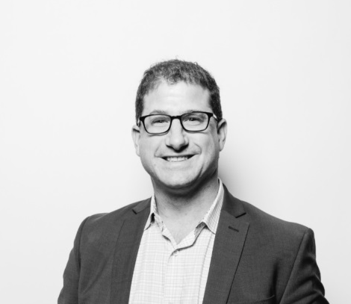
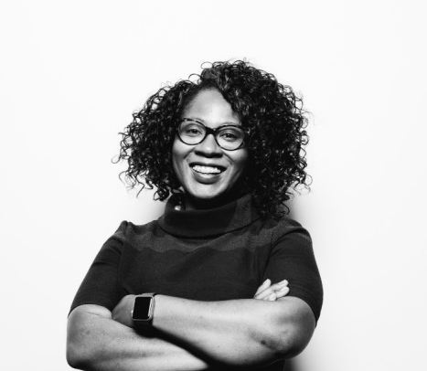
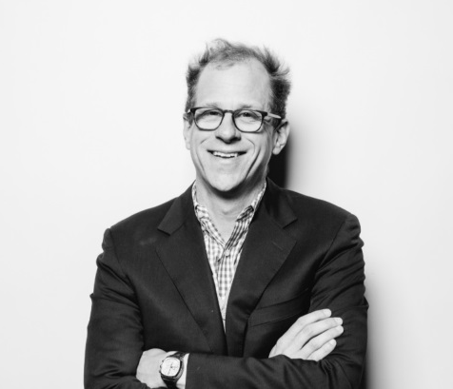
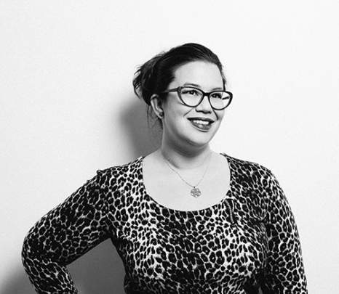
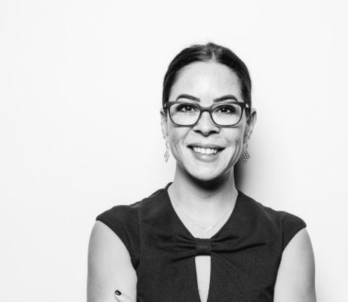
A United Force for Change
When members of the HBA come together, it’s with a shared purpose: to be a united force for change. We connect diverse groups of both women and men, across all healthcare
and life science disciplines.
By taking focused action to advance our mission, we are creating a powerful movement that directly drives professional opportunity and corporate growth.
We believe that by joining forces in the relentless pursuit of gender parity, we are doing more than uniting individuals—we are strengthening the business of healthcare.

Slide 10
Women In Science Affinity Group
Our Mission
The mission of the HBA Women in Science (WIS) initiative is to
Provide women in scientific roles with professional support for their career advancement.
Offer interactive, empowering, educational, professional development programs
Create a platform or effective networking and collaboration within the HBA organization.
WIS membership includes women with an MD, PhD, PharmD, RN, RPh or other medical/scientific degree and/or women who are working in a research, engineering, medical, or regulatory function within the healthcare industry.

Slide 11
What is Women In Science ?
Our History
In early 2004, the HBA Boston Chapter introduced the Women in Science Initiative (WIS) concept and formed a committee consisting of women scientists from various companies and professional backgrounds.
In May 2005, the Boston Chapter WIS team created and presented a WIS proposal to the national HBA organization.
These efforts resulted in the establishment of WIS as a core affinity group in the HBA, the creation of a WIS Affinity group in the Metro Chapter and finally in 2006, the creation of a Global WIS Committee.
WIS efforts are now underway in multiple regions and affiliates with programming.

Slide 12
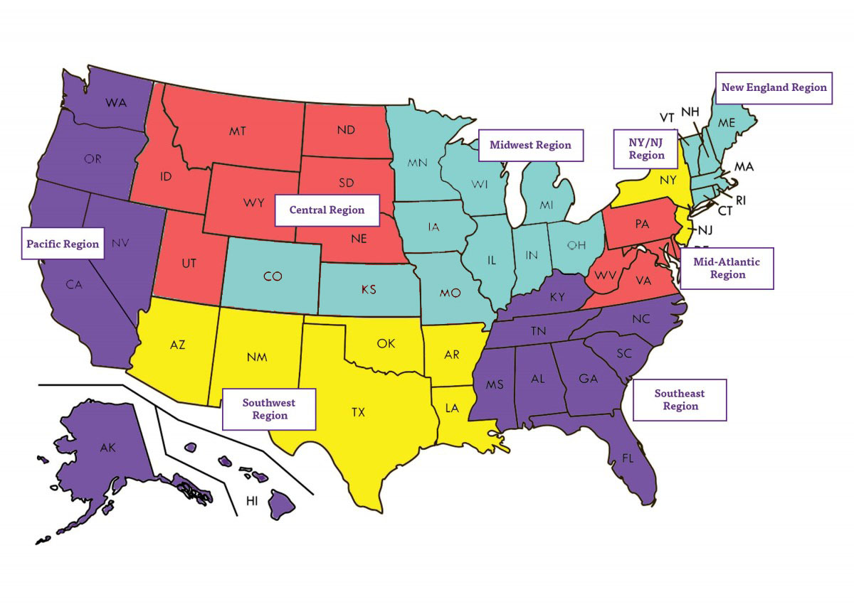
WIS Affinity Group…in your HBA region
HBA Midwest region
Cincinnati chapter
Saint-Louis chapter
HBA New England region
Boston chapter
HBA NY/NJ region
New York chapter
HBA Pacific region
San Francisco Bay Area chapter
HBA Mid-Atlantic region
Philadelphia chapter
HBA Southwest region
Dallas - Forth Worth Chapter

Slide 13
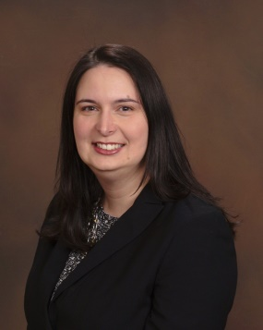
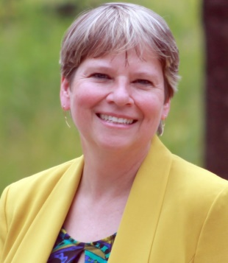
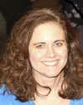
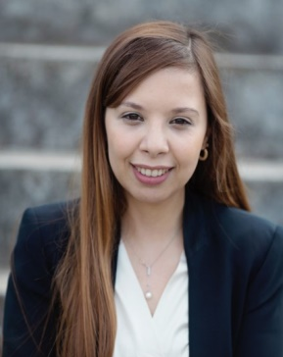
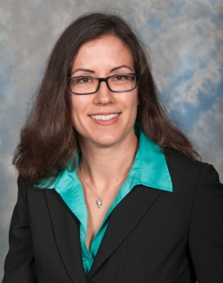
WIS Global Leadership Team
Chair
Linda Brock, PhD
Principal Scientist, vaccines
Pfizer
Manager, Global Programming
Ruth Martin, PhD
Strategic safety advisor, oncology
AbbVie
Vice-Chair
Melanie Cooke,
Senior associate scientist,
pre-pivotal drug product
Amgen
Manager, Communications
Malika Makhlouf, PhD
Project Leader R&D
Synphabase AG
Director of Operations
Rebecca Casaubon, PhD
Scientist, small molecule discovery
Teva

Slide 14
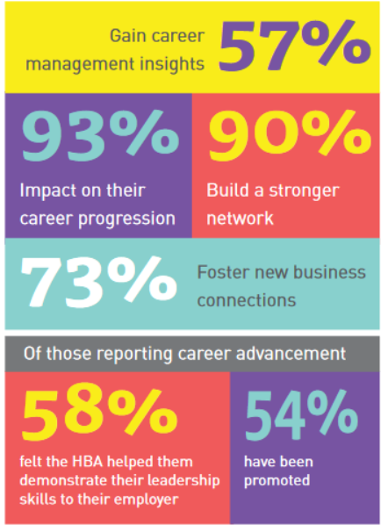
Why Join HBA WIS?
Exceptional access to senior women leaders and inspiring role models in the healthcare industry.
Educational opportunities and networking to women with scientific backgrounds.
Receive the WIS Newsletter, participate in our global social media efforts, and attend events designed by scientists, for scientific careers supported by the HBA.

Slide 15
Get involved!
Linkedin
HBA Women In Science Afiinity Group
www.linkedin.com/groups/2666428
Twitter
@HBAnet, #HBAWIS, #HBAImpact
twitter.com/hbanet
#HBAImpact #HBAWIS #4GenParity
Visit
HBAnet.org,
hbanet.org/women-in-science-2
Contact us:
hbawis@hbanet.org
Become a member!
Designate in your HBA membership profile your membership of the WIS
Affinity Group.

Slide 16
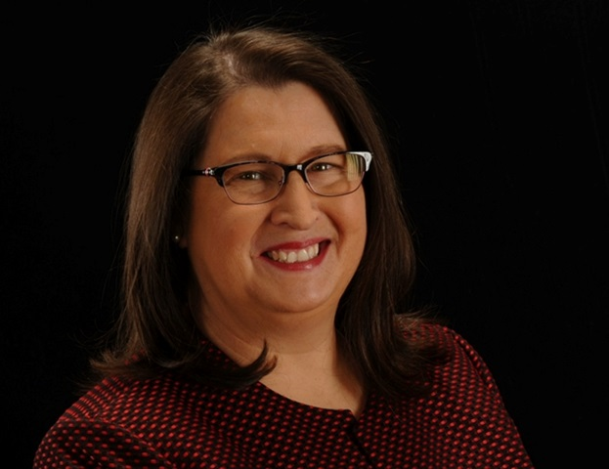
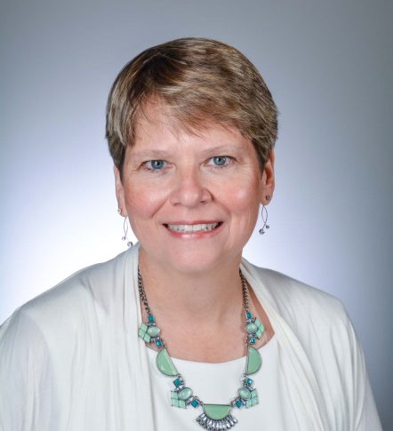
WIS Annual Conference Reception Organizers
Ruth Levy
Principal and Founder, Innovation Resolution
Director Project Management, Amerisource Bergen
HBA Mid-Atlantic WIS DAL
Ruth Martin, PhD
Principal Scientist
Strategic Safety Advisor,
AbbVie
HBA Midwest Region
Programming COE President

